Slide 1
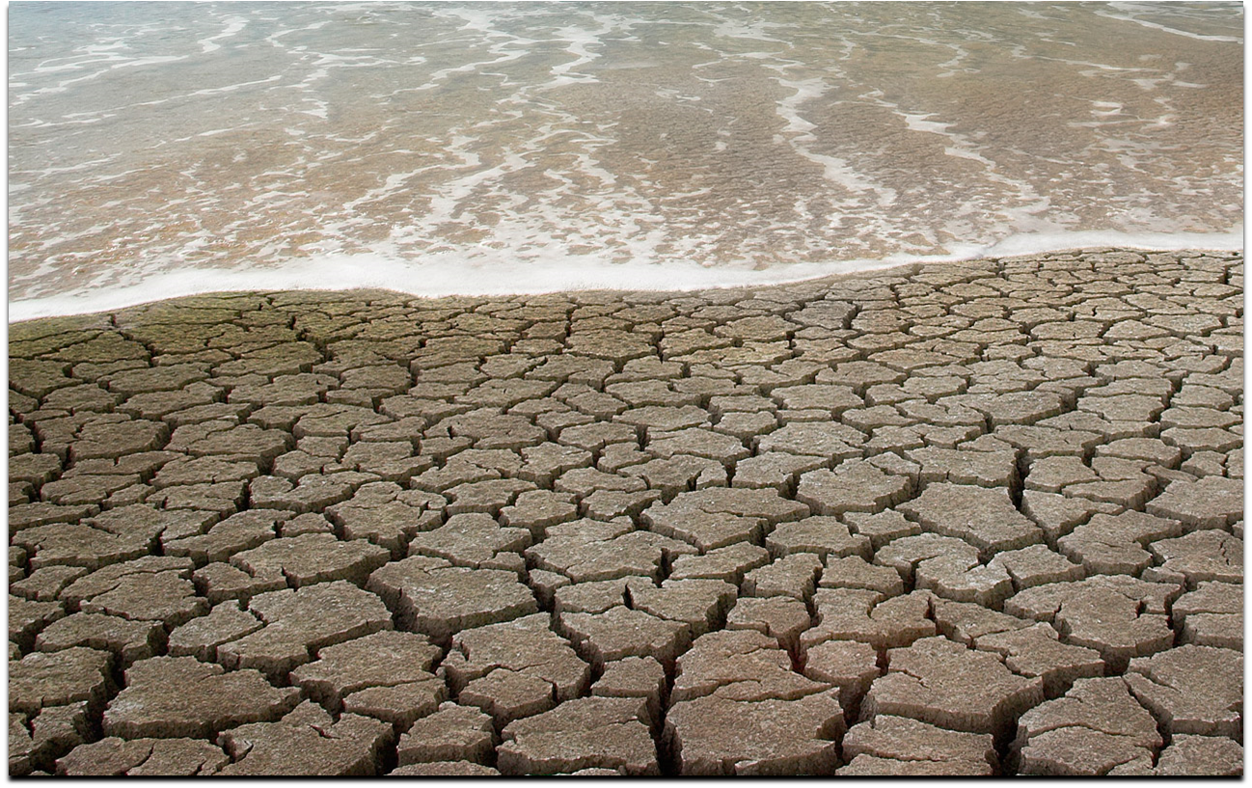
Simulation of Water Distribution
Alex Miramontez

Slide 2
Background of the Problem
Where does water go after it is used in your homes?
Potable water is used.
Water is pumped to treatment facility
Used water becomes reclaimed water and is pumped to parks, golf courses, etc.

Slide 3
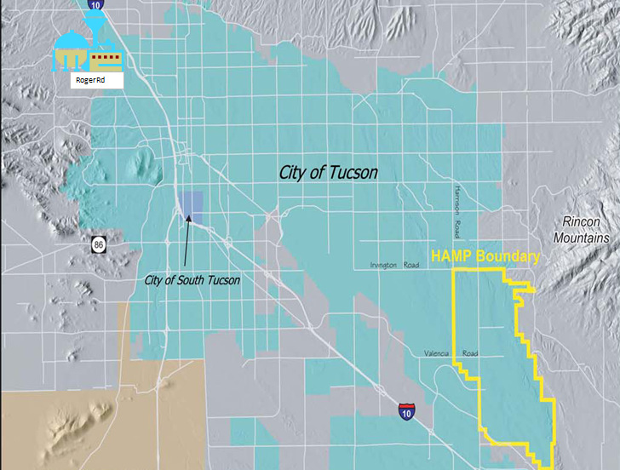
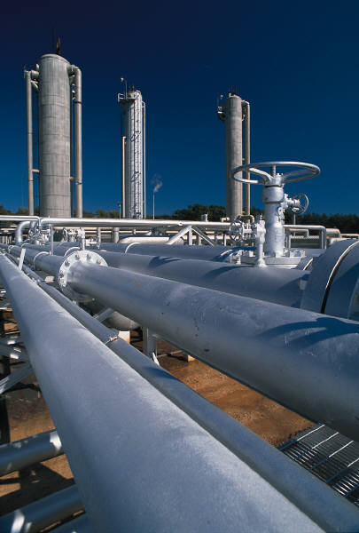
What is the Problem?
One treatment facility in Tucson.
  Located at Roger Road
Expensive economically and environmentally to pump water to all areas of town.
  HAMP area is located 25 miles outside Tucson
What if a treatment plant was located closer to demand points?

Slide 4
Research
This overall research project continues, but how do we educate and influence the public?
  Educational outreach is mandatory for the research project.
Create an educational tool that clearly portrays the problem.
  Simulation model representing a water distribution system.

Slide 5
Objective of the Model
Educate the user of the situation in an interactive game.
User must attempt to create a water distribution system with the lowest cost and satisfying the most demand.
  Model must connect to the Cost Analysis created by Gwen Woods.
My Research Project: How to get this done!
  Microsoft Excel: Visual Basic for Application (VBA) programming language.

Slide 6
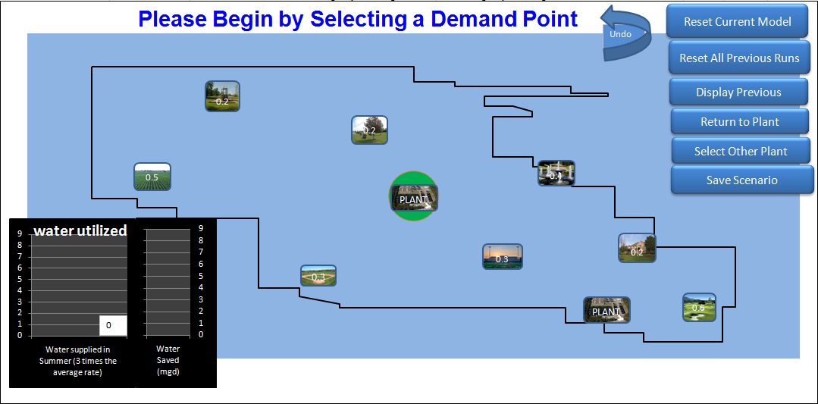
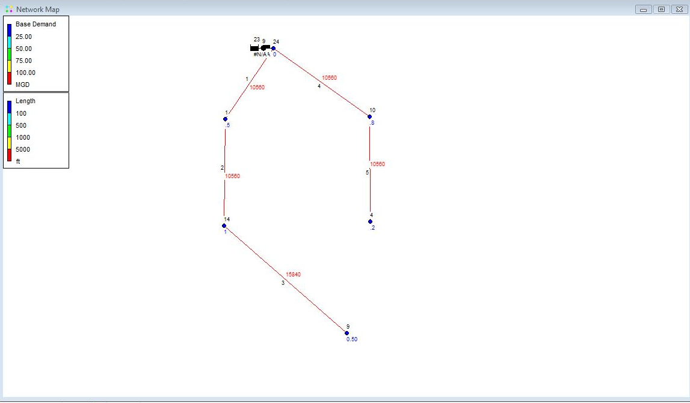
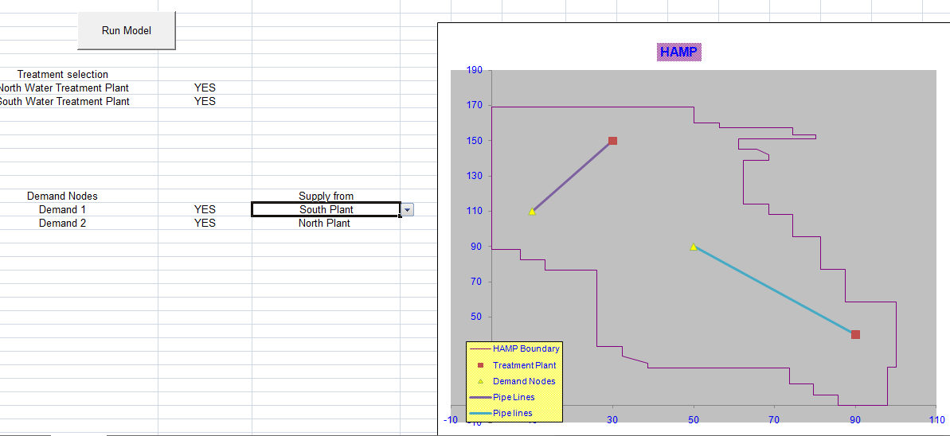
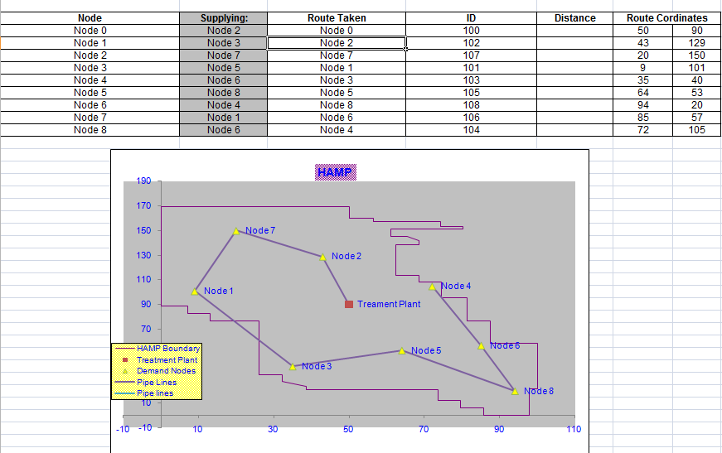
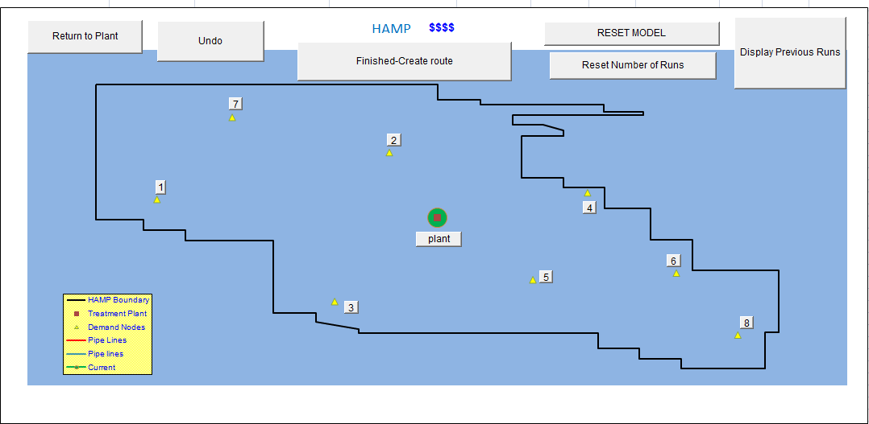
Progression of the Model
Previous Model:
Traveling Sales Person Problem
Future Model:
Connect nodes
Display cost
User Friendly
Aesthetically Pleasing

Slide 7
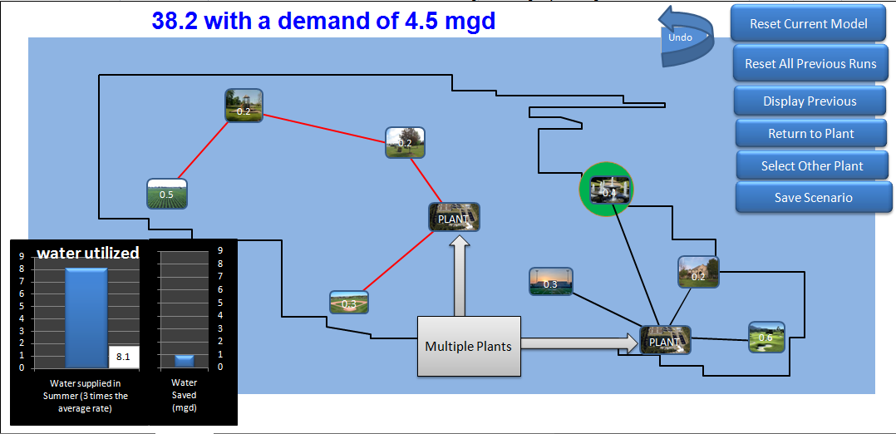
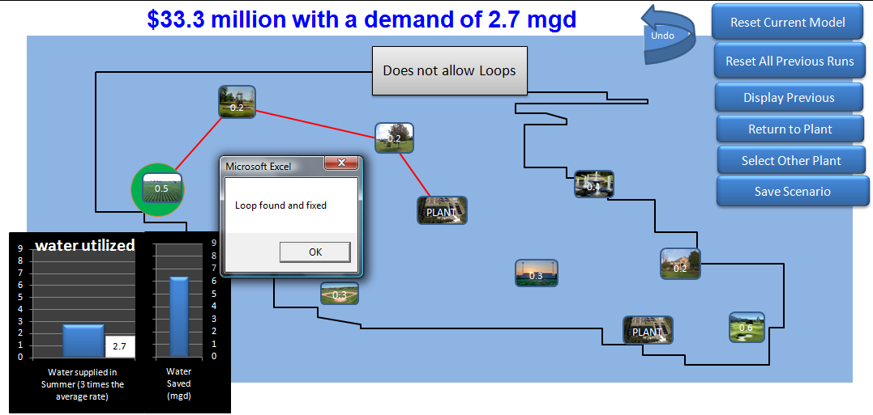
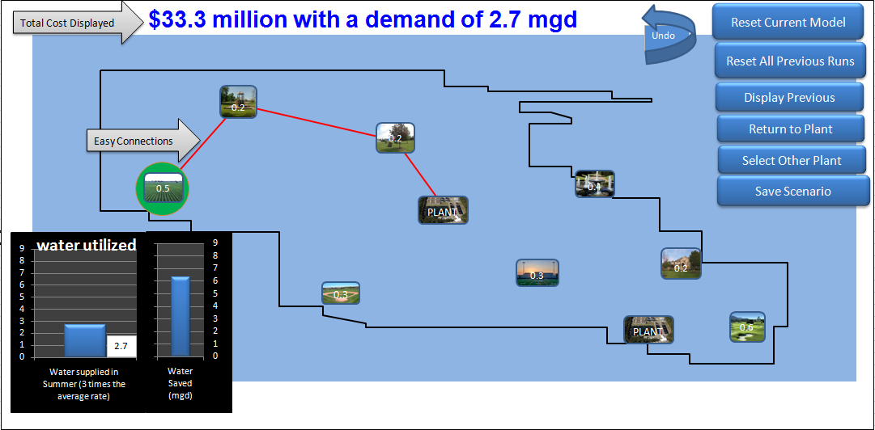
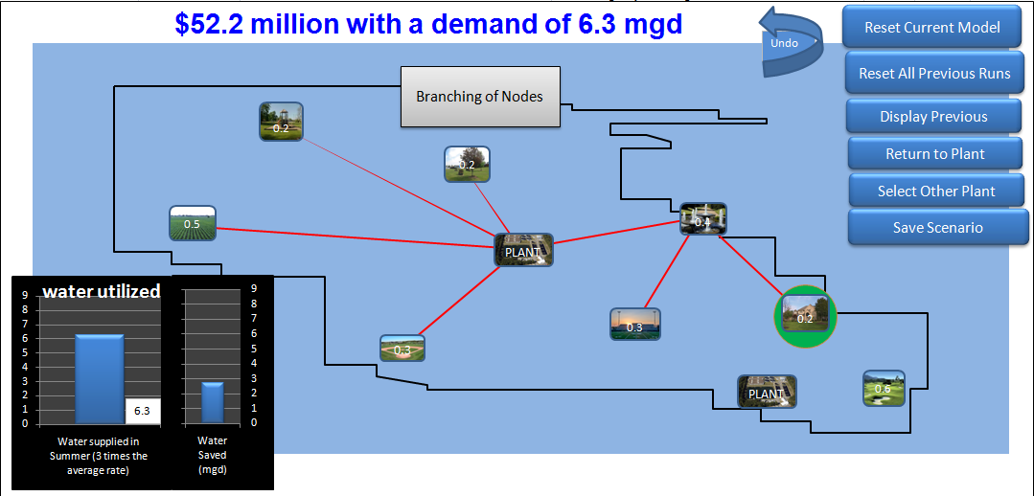
Features of the Model

Slide 8
Results of Project
Fully functional Model with cost analysis implementation
Multiple features available
  Branching
  Multiple Plants
  Error Proof
  Easy Buttons
User friendly and clearly illustrates the problem.

Slide 9
Future for the Model
Test implementation of model
  Allow a group of students to play the game.
Possible revisions to model
  More rules, features, and level of complexity
Implement and become the educational model used for the research program.

Slide 10
Special Thanks to
Gwen Woods
Dr. Robert Arnold
Dr. Guzin Bayraksan

